Slide 1

Project Report on ’Face recognition attendance system” Bachelor of Engineering Computer Science & Engineering . Submitted by Sumit suresh jade
Under the Guidence of
Prof. C.R INGOLE
DEPARTMENT Of Computer Science & Engineering
PROF. RAM MEGHE COLLAGE OF ENGINEERING AND MANAGEMENT
BADNERA-AMRAVATI
2022-2023

Slide 2
Content
✓ INTRODUCTION
✓ WORKING PRINCIPLE
✓METHODOLOGY/APPROACH
✓ ADVANTAGES
✓ DISADVANTAGES
✓ REFERENCE
✓ SCHEMATICS
✓ CODE

Slide 3
Overview
Face Recognition Attendance System
Here we are trying to process a video input taken from a camera so that we can recognize human face and mark the attendance of that face.
SOFTWARE USED IN THIS PROJECT
Visual Studio Code
Python
Open cv
Face recognition

Slide 4
Introduction
Face Recognition Attendance System is intended for checking and monitoring attendance using face recognition. The system will store the faces of the students in a database.
Face recognition systems can also be used to track attendance in schools, colleges, and companies. Because the existing manual attendance system is time consuming and difficult to maintain, this system intends to create a class attendance system that employs the concept of face recognition.

Slide 5
WORKING PRINCIPLE
The camera in our device is used for this project.
It Recognizes our Face along with Facial Features and find wheather this facial data is available in our data.
After Recognition of face it Marks attendance in CSV file along with Date & Time

Slide 6
ADVANTAGES
Easy to use
Hassle free
Fun to use
More interactive
Time Saver

Slide 7
DISADVANTAGES:
Don’t Works in case of electricity Failure
REFERENCE :
https://www.geeksforgeeks.org/introduction-to-opencv/
https://www. Youtube.com/i-know-python

Slide 8
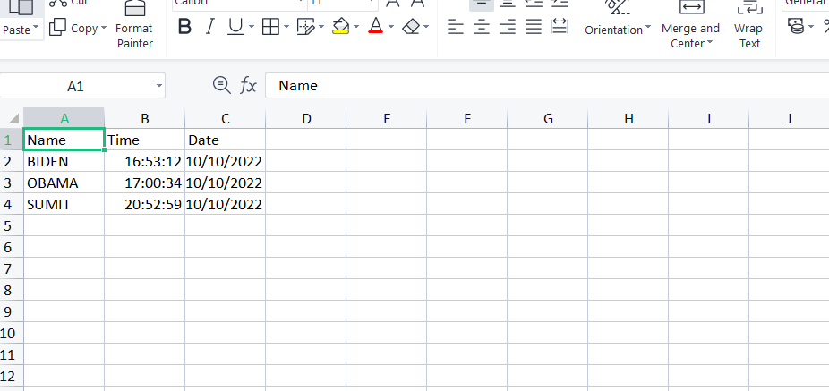
SCHEMATICS
Output in csv file

Slide 9

Code :

Slide 10
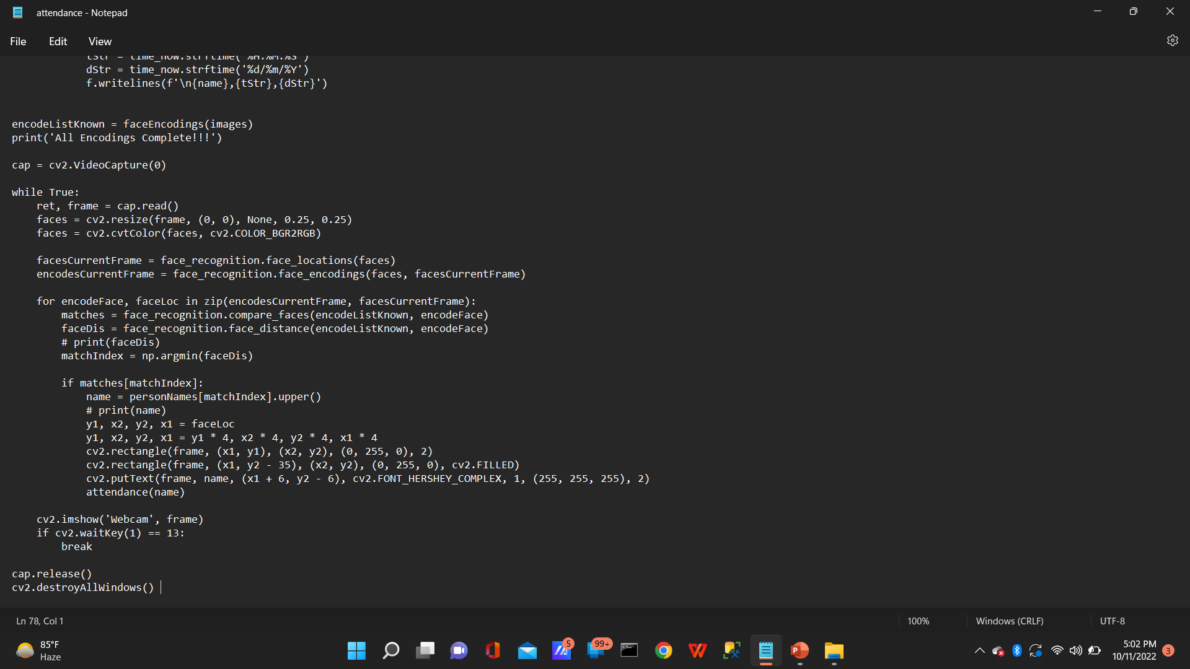

Slide 11
Thank
You

